Slide 1
URL module
The url module provides utilities for URL resolution and parsing. It can be accessed using:
var url = require('url');

Slide 2
URL module
A URL string is a structured string composed of several meaningful components.
Url module is one of the core modules that comes with node.js, which is used to parse the URL and its other properties.
The Node.js URL Module is provided to perform operations with address URLs.
We can split a web address into manageable parts.
A URL string may carry information including the protocol such as https, the hostname, query string values, and more.

Slide 3
URL module
var { URL } = require('url');
var adr = 'http://localhost:8000/default.htm?name=Raj&Age=20';
var q = new URL(adr);// This line of code creates a new instance of the URL object by calling its constructor with the argument adr
console.log(q.protocol); // returns 'http:'
console.log(q.hostname); // returns 'localhost'
console.log(q.port); // returns '8000'
console.log(q.host); // returns 'localhost:8000'
console.log(q.pathname); // returns '/default.htm'
console.log(q.search); // returns '?name=Raj&Age=20'
console.log(q.href); // returns 'http://localhost:8000/default.htm?name=Raj&Age=20'
console.log(q.searchParams.get('name')); // returns 'Raj'
console.log(q.searchParams.get('Age')); // returns '20'

Slide 4
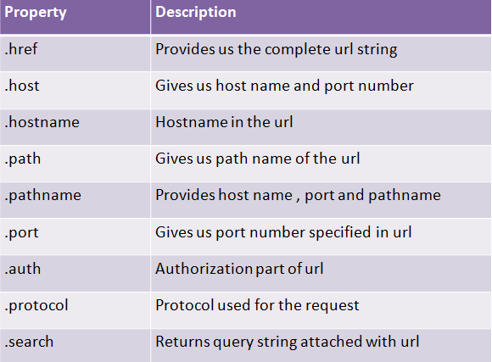
URL module

